Slide 1
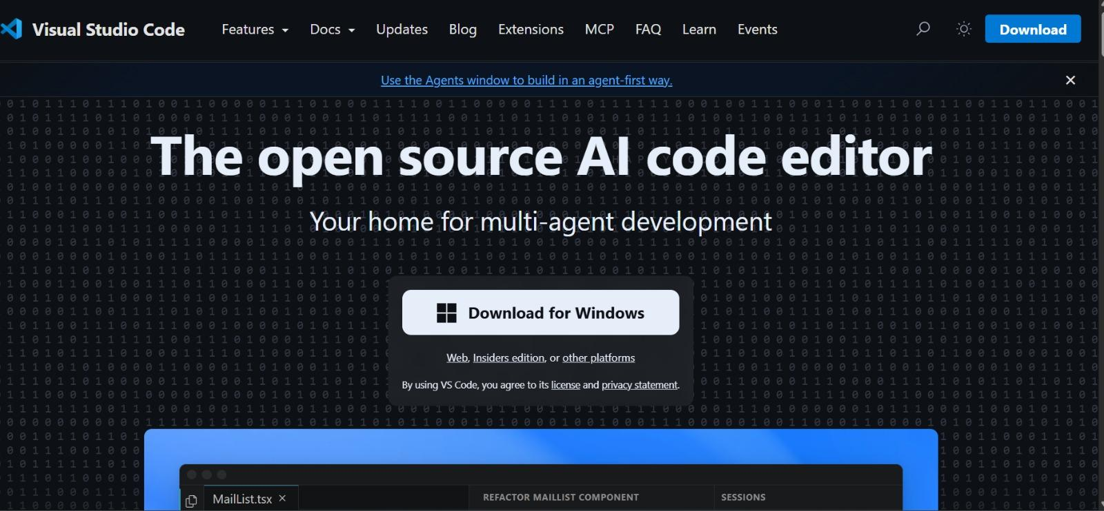
Installation of VS Code:-
1]Download VS code for windows.

Slide 2
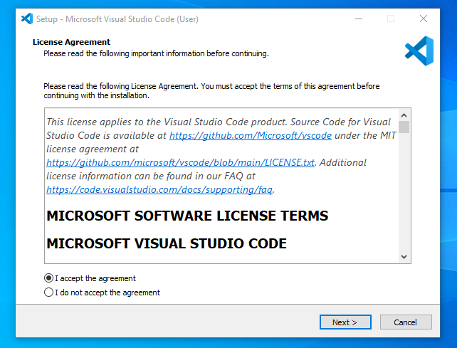
2]Download and Installation

Slide 3
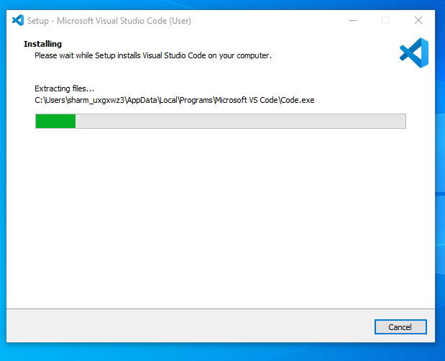

Slide 4
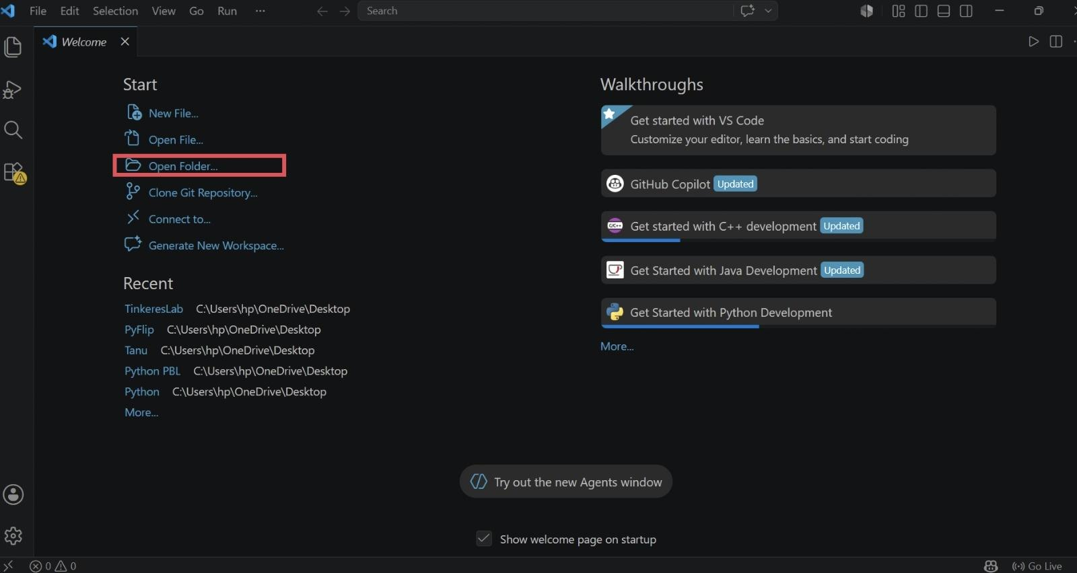
3] Open the folder:-

Slide 5
4]Select Folder

Slide 6
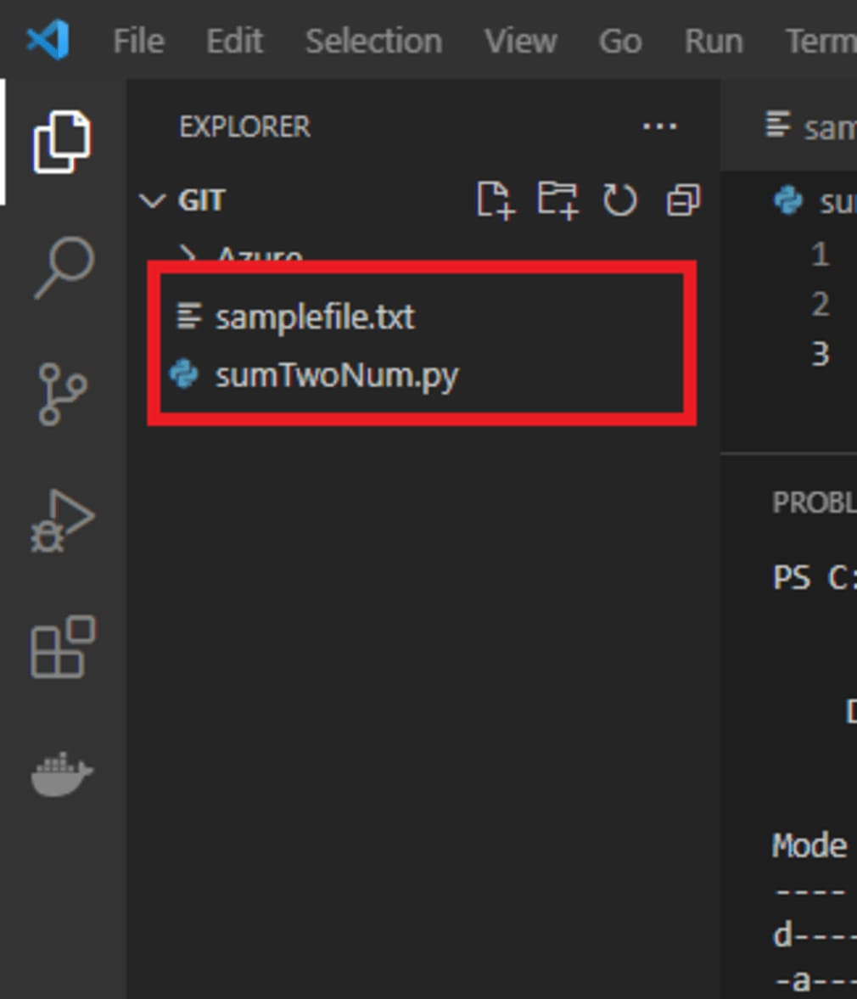
5]Select File

Slide 7
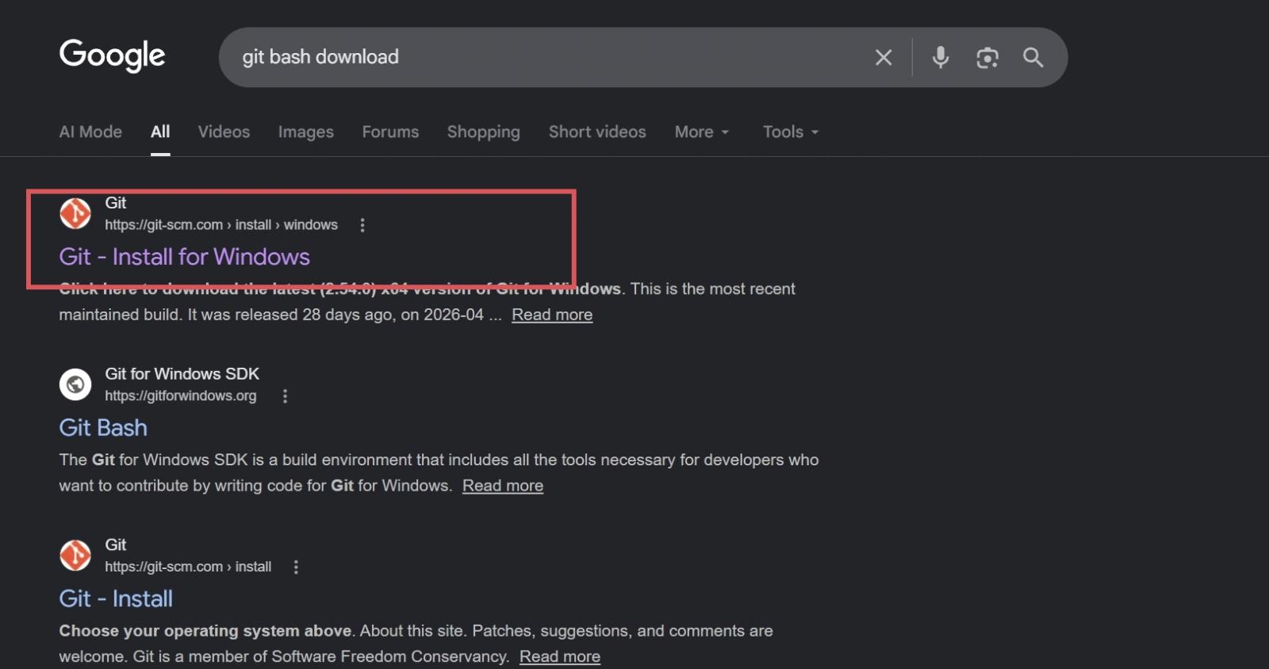
Installation of GITHUB:-
1]Download GITHUB for Windows:-

Slide 8
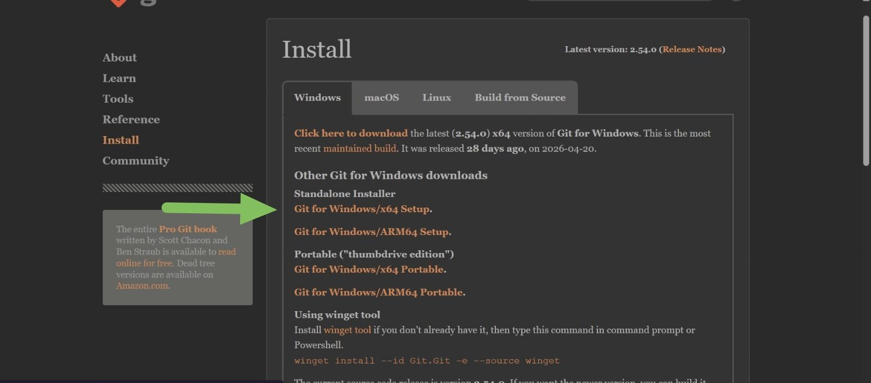
2]Download and Install GITHUB:-

Slide 9
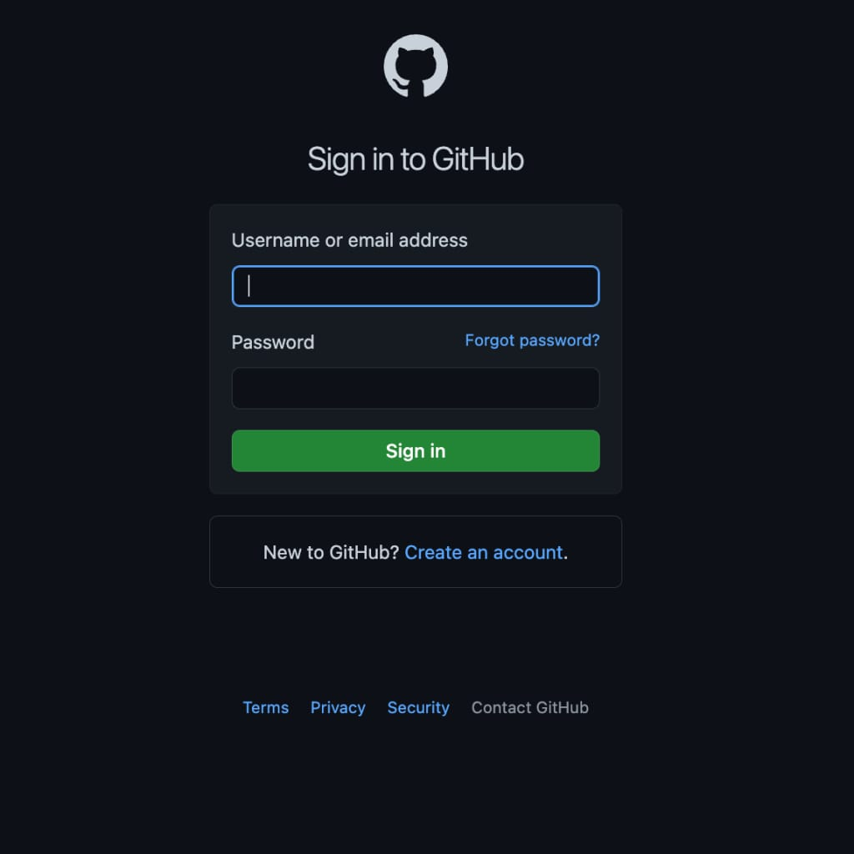
4]Create a Account

Slide 10
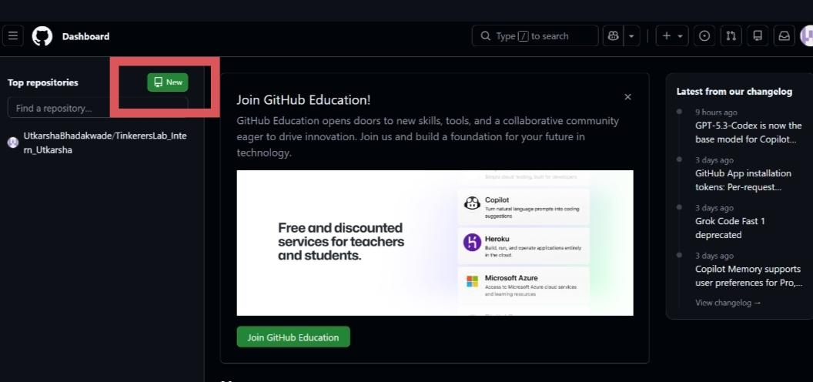
5]Create New Repo

Slide 11
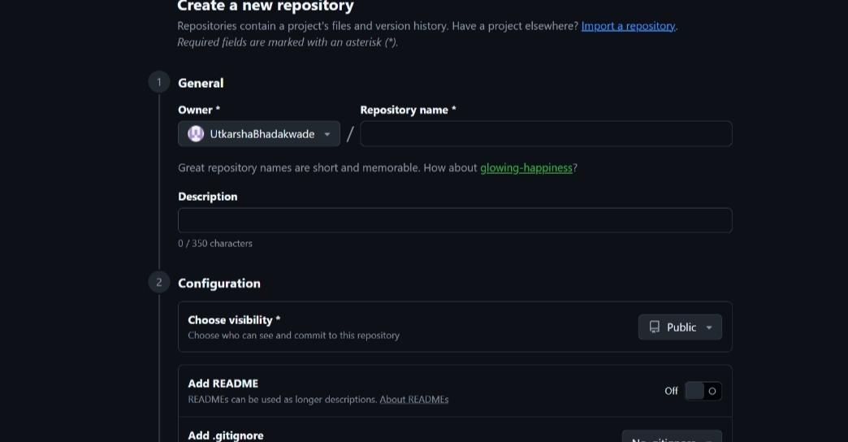
5]
-GIVE REPO NAME
-MAKE IT PUBLIC AND MAKE README ON

Slide 12
Creating Portfolio Website
Tools Used:-
1]VS CODE
2]CHATGPT
3]GITHUB
Language Used:-
1]HTML
2]CSS
3]JAVASCRIPT

Slide 13
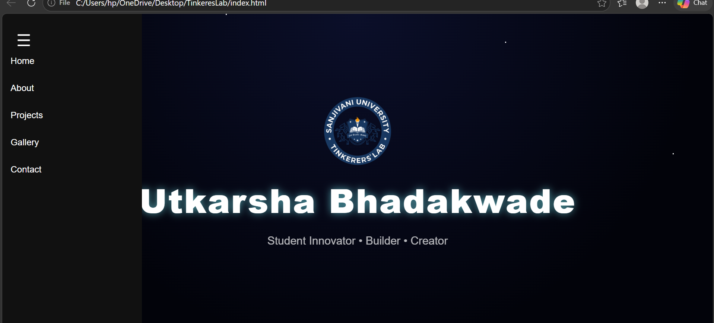
HTML :-
1]index.html(Home page)

Slide 14
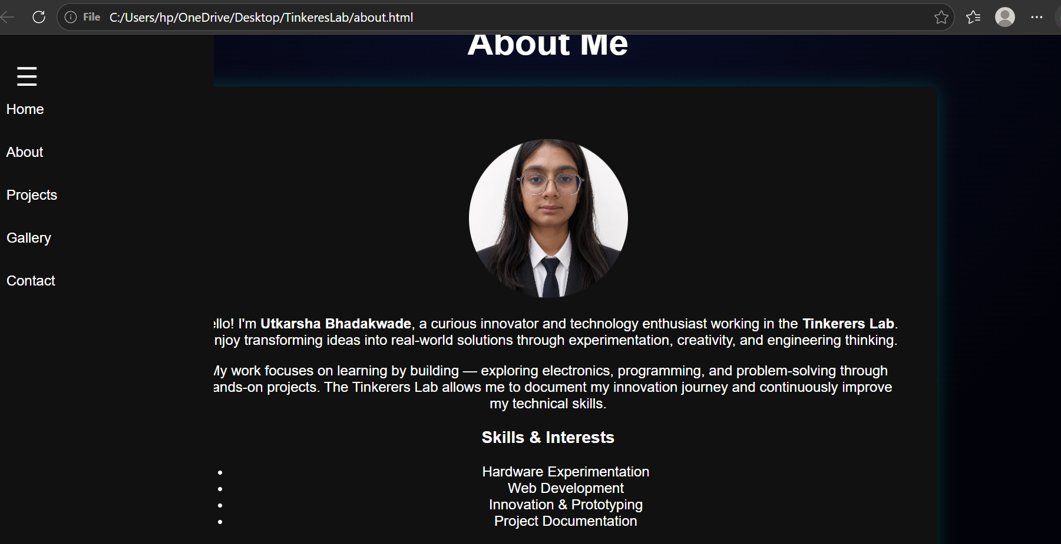
2]About Section:-

Slide 15
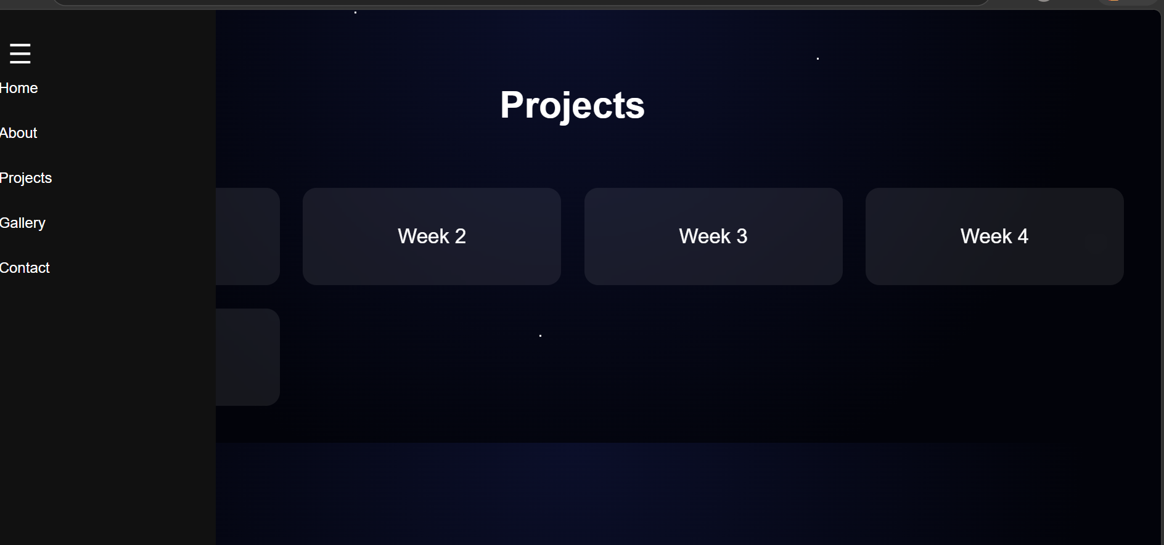
3]Project Section:-
This Section Include Week Section and Days section in it.

Slide 16
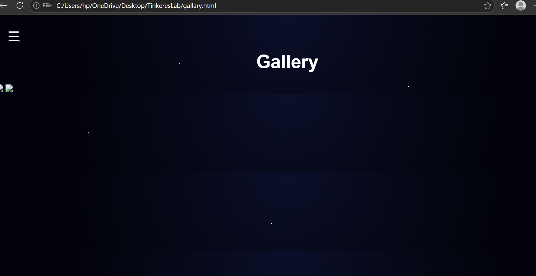
5]Gallery Section
This Section Include Photos and Videos of Activities performed during Internship

Slide 17
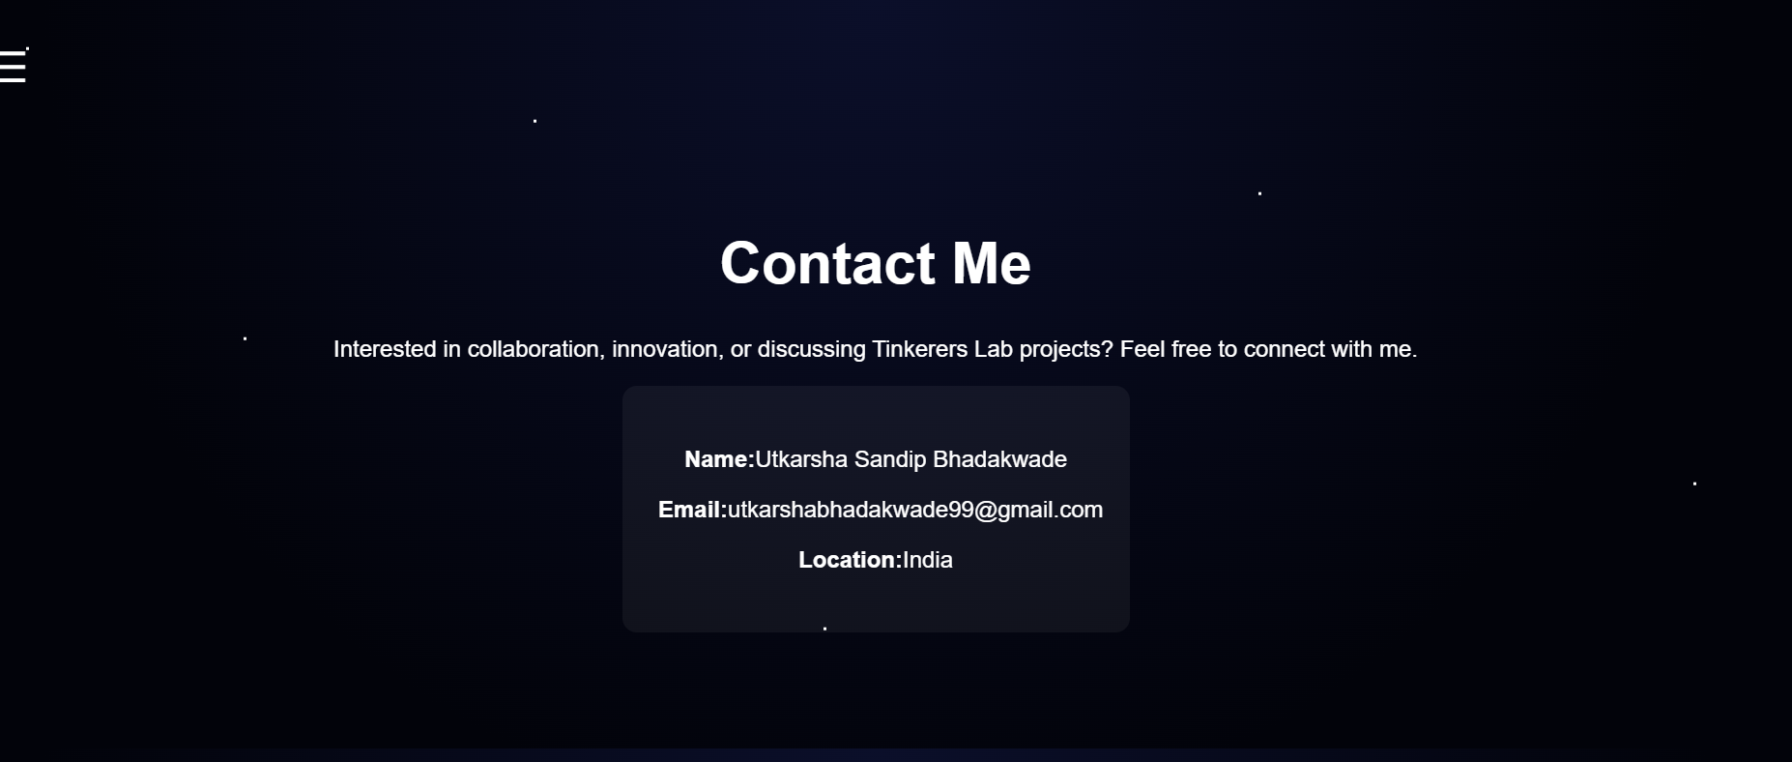
5]Contact Section

Slide 18
GITHUB PUSH
1]Initialize git in project
-git init
2]Check status
-git status
3]Add all files
-git add .
3]Commit changes
-git commit -m "your commit message"
4]Connect GitHub repository
-git remote add origin https://github.com/USERNAME/REPOSITORY.git
5]Push code first time
-git push -u origin main
6] Push updates later
-git push

Slide 19
CONCLUSION:-
1]COMPLETE INSTALLATION OF VSCODE
2]COMPLETE INSTALLATION OF GITHUB
3]CREATING PORTFOLIO WEBSITE
4]PUSHING AND MAKING WEBSITE LIVE ON GITHUB

